Slide 1
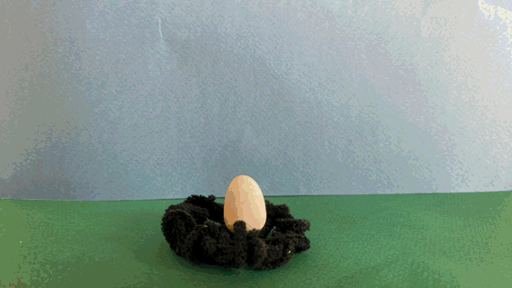
Junior Cycle Visual Art - Unit of Learning - Strand
Discipline: Stop Motion
Title: Distastrous human activity in animal habitats.
.
Student Name : Shannon Kleinschmidt
Year Group : 1

Slide 2
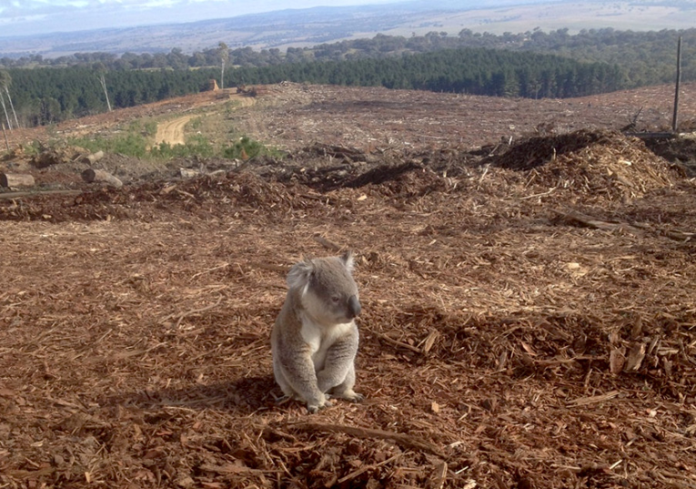
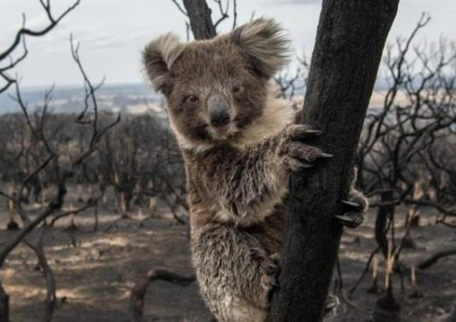
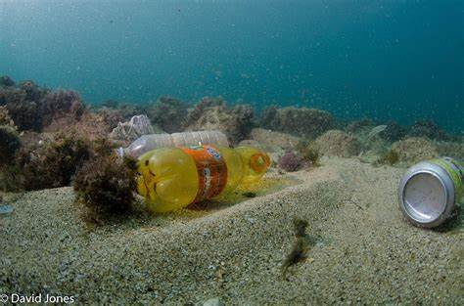
Subject matter/theme
Describe the subject matter/theme
Habitat loss is one of the leading causes of animal species extinction today and most of it is caused by human activity.
Human beings have developed processes like farming, grazing, mining and urbanisation to allow for communities to expand and thrive.
But these activities have also resulted in large portions of natural environments being cleared. In forest ecosystems, this has had a negative impact on around 80% of the plant and animal species that call these ecosystems home.
World Habitat Day falls on the 5th of October so Habitat as a topic for this UOL seems appropriate given the start date for placement falling on the 7th of October.
A habitat is a place where an organism makes its home and meets all the environmental conditions it needs to survive. It provides everything an animal needs to find food, select a mate, and reproduce. But what happens when we interfere with these habitats?
Habitats are often destroyed by human activities such as urbanization, wildfires like those in Australia, and oil spills in lakes. Habitat destruction, or habitat loss, occurs when natural environments are altered or removed, making them unsuitable for the species that live there. This is primarily caused by deforestation, urbanization, agriculture, mining, and pollution. These actions lead to a decline in biodiversity and can result in species extinction.
To explore this issue, I will create groups of three students and ask them to research events where habitats and animals have been displaced due to human activity. Each group will create a scene based on a researched event and make a stop-motion video using editing tools and the Inshot stop-motion app. They will create characters (dough characters) that resemble the actual animals involved in these tragedies, reform them, and video them in motion as fluidly as possible with influence from Richard Webbers videos. The characters will tell a story of the devastating impact humans are having on their environment.
Students need to realize 3 stages before planning their storyboards. I want them to identify and remake these 3 stages for each stop motion:
Before (Happy and healthy habitat)
Big event (Human Destruction)
Post Habitat remains and realization
Relevant links:
Habitat Destruction Animation. If roles were reversed
https://youtu.be/p7LDk4D3Q3U
The Global Impacts of habitat destruction
https://news.nationalgeographic.org/the-global-impacts-of-habitat-destruction/
https://youtu.be/Ic-J6hcSKa8
Clay stop motion on oceans?
https://youtu.be/WKbcE3sKcJE
Stop motion introduction:
https://youtu.be/61at-L3auWU

Slide 3
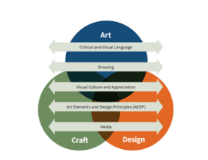
Year Group:
No. of Pupils:
No. of weeks:
From:
Strand(s):
Art/Craft/Design
JC Visual Art Learning Outcomes (LO)
How do you know that they know? (Assessment)
Critical and Visual Language
3.2 use critical and visual language to explain their own designs and those of others.
Drawing
3.6 design a final work based on their drawings.
Visual Culture and Appreciation
3.8 discuss historical and contemporary design practices.
Art Elements and Design Principles
3.12 assess their own and others’ design
work using their knowledge of art
elements and design principles.
Media
3.14 utilise media in their own design
work based on a design brief.
3.2 Through regular critiques I hope to assess the descriptive language used by my students to describe their own and peer work.
I will be looking for evidence that within groups all members can justify each others reasons for certain developments in their work.
3.6 Evidence of a process of development with resemblance shown throughout sketches in a notebook to create the storyboards and scenic backgrounds. Evidence of annotations and self-directed realizations.
Final stop motion video reflects pre-planned storyboards.
3.8 Reference to inspirational artists and concepts they have gathered from these artists and transferred into their own work.
An effort to discuss, question and/or recreate techniques they have seen in artist reference videos.
3.12 Valuable critique points made by peers and suggestions made to help one another.
3.14 Steps followed as instructed in the correct order with the inclusion of the asked media to be used to reach final stop motion video.
Effort given to mold and construct characters to a recognizable likeness to supporting imagery students have found.
Materials and resources:

Slide 4
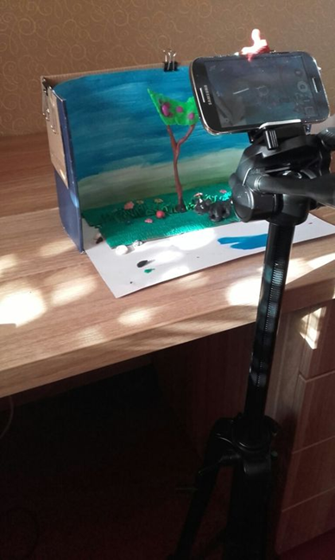
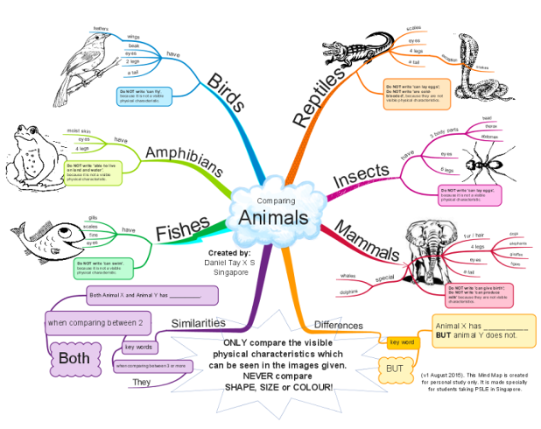
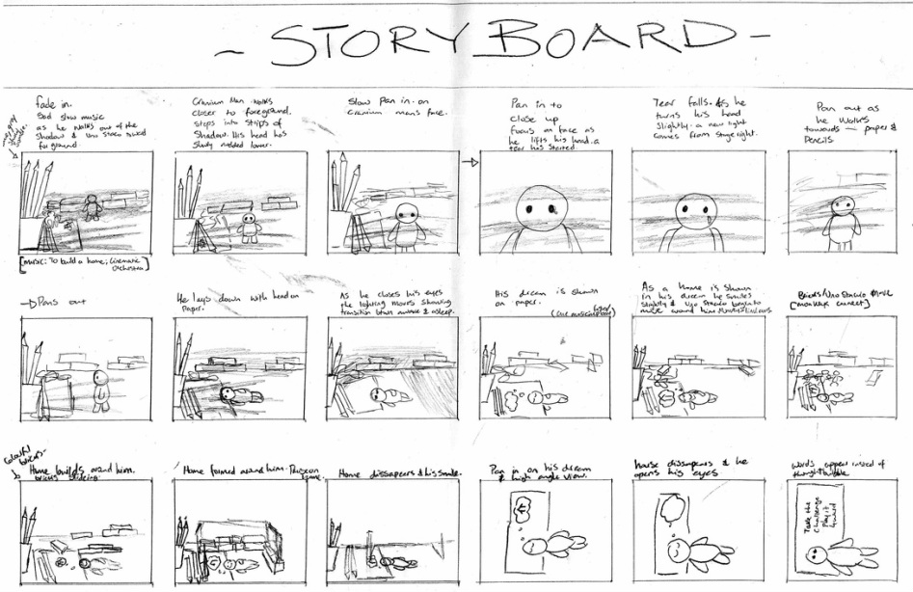
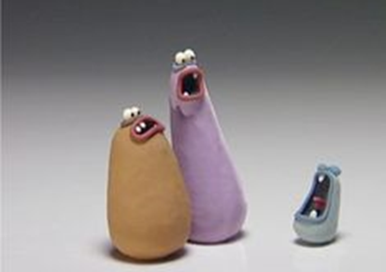
Visual Timeline
Work that will be created and assessed:
Week 1:
Mindmap centered around the word Habitat
Take students outside to draw habitats on a small scale from images they take on tablets/sketchbooks and pencil outside.
Visual research page about 1 destructive event caused by humans.
Week 2:
Make groups and decide on animation story to create story-board poster in pencil on A3 to prepare for rolling out of the stop motion
Week 3:
Scenic Backdrop
Prelimenary drawings of characters sketched into sketch-book. Identify key features with notations.
Week 4:
Accessories to back-drop (Trees, Rocks, clouds, Trucks, fires etc.)
Homemade Gluten-free playdough given that the UOL runs to schedule. Alternatively store bough playdough will be brought into the class.
Week5:
Playdough characters.
Week 6-8:
Stop motion video recorded.
Week 9:
Stop motion video edited.
Week 10:
Cinema day in the classroom at the end of the week to watch peer videos across all classes and review.

Slide 5
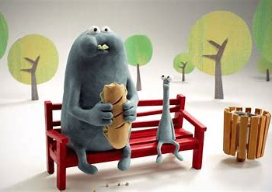
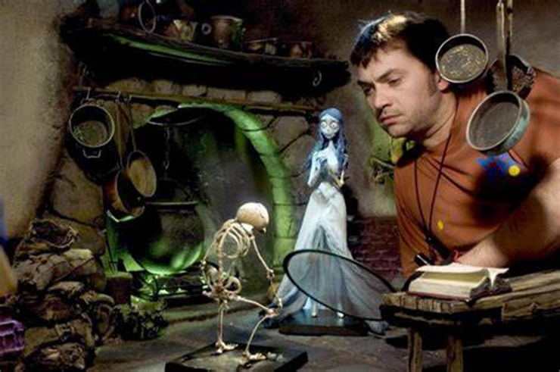
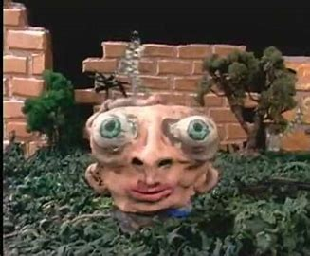
Research and Investigation
Image from ‘Bench’ by Rich Webber
Making of the ‘The corpse Bride’ by Tim Burton
Image from ‘Prometheus Garden’ by Bruce Bickford
Learning Intentions:
(Knowledge/Concepts/Skills/Attitudes)
To independently research a habitat issue in the world and learn how develop and create a short narrative from this. (1)
To learn of the impact humans have had on animals environment. (1)
To learn the steps involved in planning and creating a stopmotion. (4,5)
Team work and compromise. (1)
Learn about the history and different types of stop-motion animation, such as claymation, cut-out animation, and object animation. (3)
Study examples of stop-motion films to understand the techniques and styles used. (3)
Analyse and compare and contrast the good qualities in stop motion between the above stop motion artists (Rich Webber, Tim Burton and Bruce Bickford). Study the unique techniques and styles of each artist. Identify the strengths and innovative aspects of their work. Compare their approaches to storytelling, character design, and animation fluidity. (1,3)
The Five Elements of Visual Art
1. Critical and Visual language
2. Drawing
3. Visual Culture and Appreciation
4. Art Elements and Design Principles
5. Media

Slide 6
Research and Investigation
The Five Elements of Visual Art
1. Critical and Visual language
2. Drawing
3. Visual Culture and Appreciation
4. Art Elements and Design Principles
5. Media
Sketchbook work
List relevant activities:
Habitat mindmap
Valuable annotations about habitats and how valuable they are.
Prelimenary drawings of found habitats.
Research - Initial Ideas
Outline teaching and learning activities:
I will ask students to create a mind map around habitats and what they think of when they hear the word habitat with examples. (1)
As the teacher I will create a PowerPoint presentation on the brief for the next 8 weeks as well as an introduction to what a Habitat is and why it is valuable in our environment. We will discuss this. I will also highlight some examples of how we as humans are making it difficult for these animals to live in their habitats. (1)
I will take students out of the class onto the school grounds to identify habitats on a small scale. (3)
Students will draw different types of habitats they have found into their sketchbooks. (2)
Students will watch exampler stopmotion videos and rate what makes each stop motion successful. (3)
Story-telling of devastational impacts humans have on animals in different habitats. E.g Oceans (Beached wales , birds that cannot fly out of the water, Wild Fires affecting Koalas and birds in Australia. Lakes and agricultural waste being swept into damns and fish dying in Loch Neagh Ireland. Deforestation and bulldozers in the Amazon. Conservation in Zimbabwe, animals displaced for golf courses and dams) (1)
Choose a specific habitat issue (e.g. deforestation, ocean pollution).
Gather data and real-life stories related to the issue. (1)
Develop a narrative that highlights the impact and possible solutions (1)
Digital Resources
Purple and brown
https://youtu.be/cdecrgQJMV0
https://youtu.be/MR7r6wi7NYU
Claymation for beginners
https://youtu.be/ZHemTNW-q9M
Heatwave Claymation video *Only play first couple of minutes
https://youtu.be/4nU_QcjVu9A

Slide 7
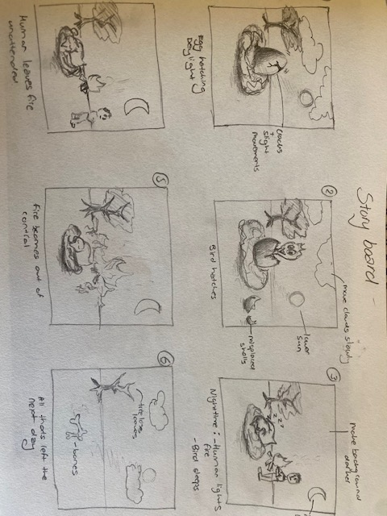
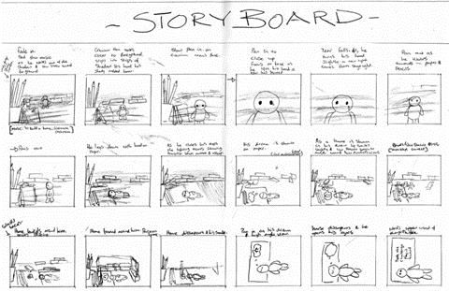
Exploration and Concept Development
Storyboard
Learning Intentions:
Develop a compelling story or concept. This includes creating a storyboard to plan out each scene and shot. (1,2)
Learn how to work in groups and assign peers responsibilities.
Learn basic drawing skills. (2)
Investigate the technical aspects of stop-motion, including camera settings, lighting, and frame rates.(5)
Learn about the software and tools needed for capturing and editing stop-motion animations. (5)
Understand how to create and manipulate props and characters to achieve the desired effects. (5)
Study the principles of animation, such as timing, spacing, and movement, to make the animation smooth and realistic. (3,5)
Understand the importance of copyright laws and how to use music, images, and other media legally. (3)
Learn about safety precautions when working with equipment and materials. (4)
The Five Elements of Visual Art
1. Critical and Visual language
2. Drawing
3. Visual Culture and Appreciation
4. Art Elements and Design Principles
5. Media

Slide 8
Exploration and Concept Development
The Five Elements of Visual Art
1. Critical and Visual language
2. Drawing
3. Visual Culture and Appreciation
4. Art Elements and Design Principles
5. Media
Sketchbook work
List relevant activities:
Storyboard
Character design
Initial Ideas - Process of Development
Outline teaching and learning activities:
Collection of photos of the animals and habitats the students will recreate. (5)
Creating their own Playdough with food colouring and gluten-free flour to create 3d pieces from the clay for the background and characters. (5)
Brainstorming Sessions: Encourage students to brainstorm story ideas in groups. This fosters collaboration and creativity. (1)
Creating Storyboards: Have students create storyboards that outline each scene of their clay-mation. This visual planning helps them organize their ideas and plan the sequence of events. (2,4)
Review and Feedback: Provide feedback on their storyboards and encourage peer reviews to refine their ideas. (1,3)
Modelling Characters: Teach students how to create clay characters, focusing on basic sculpting techniques. (5)
Designing Sets: Guide students in designing and building simple sets for their clay-mation. This can include background elements and props. (4,5)
Introduction to Stop-Motion: Explain the basics of stop-motion animation and demonstrate how to capture frames using a camera or smartphone. (5)
Tim Burton the Corpse Bride
https://youtu.be/XmfrJXX7Ptc
https://assets.moma.org/momaorg/shared/video_file/video_file/480/burton30_HD_640.mp4
Richard Web- Bench movie
https://youtu.be/H1cCU62loqU
Bruce Bickford- Prometheus Garden
https://youtu.be/1m-JYut7GSQ
Digital Resources

Slide 9
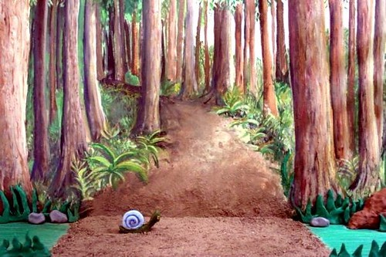
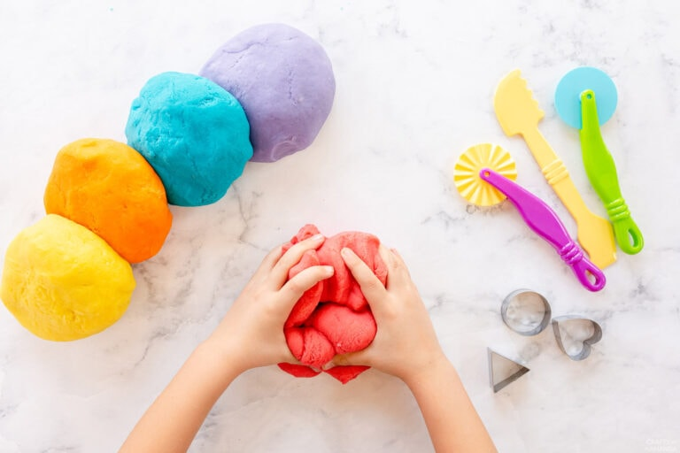
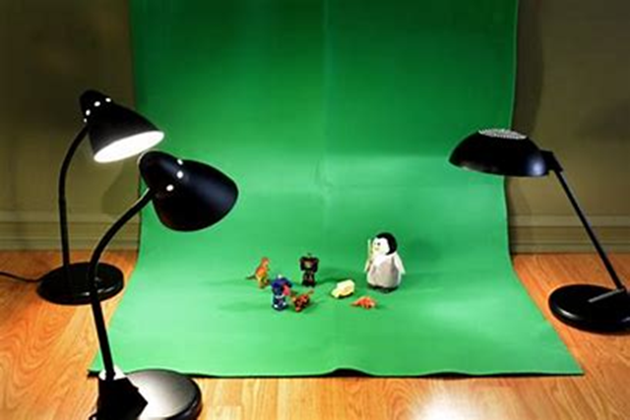
Creating a final work
Create Backdrop
Making playdough
Record and edit video
Learning Intentions:
To learn the technical skills required to gain hands-on experience with stop-motion animation techniques, including character modeling, scene setup, and frame-by-frame shooting aswel as learn how to sculpt and manipulate playdough figurines to represent movements. (2,3,5)
To be able to create a 3D animation from a 2D storyboard therefore learning how to work from a plan. (4,5)
To comfortably use technology to create effects and bring their stories to life with the use of sound effects, clip and cropping tools available on the InShot app. (1,4,5)
Students learn to express their ideas and stories through the medium of clay and animation, fostering creativity and imagination (1,5)
Students learn to use their storyboard ideas, plan scenes, and manage their time effectively. (2)
This Claymation project is done in groups, helping students develop teamwork and communication skills as they work together to bring their stories to life. (1)
Students encounter various challenges during the creation process, such as maintaining character consistency and dealing with technical issues, which helps them develop problem-solving skills. (5)
Claymation combines visual, auditory, and kinesthetic learning modes, helping students understand and communicate ideas in multiple ways. (1,3)
The Five Elements of Visual Art
1. Critical and Visual language
2. Drawing
3. Visual Culture and Appreciation
4. Art Elements and Design Principles
5. Media

Slide 10
Creating a final work
The Five Elements of Visual Art
1. Critical and Visual language
2. Drawing
3. Visual Culture and Appreciation
4. Art Elements and Design Principles
5. Media
Sketchbook Work
List relevant activities:
Reference to storyboard
Annotations documenting the process in creating the final piece.
Process of development – Realised work
Outline teaching and learning activities:
I will show the students screencasts I have taken of myself using InShot and walk them through the different functions and effects they can create. (4,5)
I will demonstrate to the class before they begin filming by setting up a simple scene and focusing on how we can show movement in the best way possible. (1,5)
I will demonstrate how to model the playdough and the different tools we can use. (4,5)
I will show the students how we can make the characters move fluidly by slightly remodeling as we take the next photograph. (4)
I will ask the students to show each other different techniques and help each other where other groups have failed to grasp the functions on InShot. (3)
I will ask students to consider lighting when filming. (4)
Digital Resources
Gluten Free Playdough Recipe :
https://strengthandsunshine.com/how-to-make-natural-homemade-gluten-free-playdoh/
Claymation movement focus:
https://www.tiktok.com/@maralechat/video/7372519807914118433?is_from_webapp=1&sender_device=pc
https://www.tiktok.com/@claytoonstudios/video/6833126343731989766?is_from_webapp=1&sender_device=pc
https://www.tiktok.com/@guldies/video/7035648959825644806?is_from_webapp=1&sender_device=pc

Slide 11
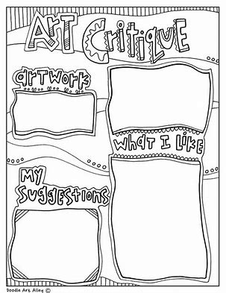
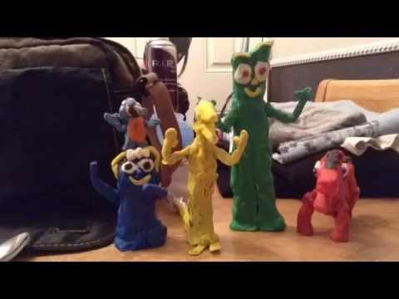
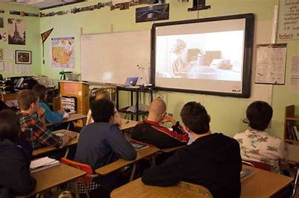
Reviewing and Presenting
Learning Intentions:
Students will note the successful elements in their work and the work of their peers and referenced artists.
Students will be able to narrate, justify and give a preview of their stop-motion videos before presenting to the class.
Students will review and generate a library of reference artists within their sketchbook.
Students will be to explain the process of their work from the idea to the final result.
They will use appropriate critical and visual language to interpret their own work and the work of others.
Students will be able to critique their work and peer work in a formal environment.
Students will learn teamwork ethics and through presenting they will learn how to peer educate in the classroom environment.
The Five Elements of Visual Art
1. Critical and Visual language
2. Drawing
3. Visual Culture and Appreciation
4. Art Elements and Design Principles
5. Media

Slide 12
Reviewing and Presenting
The Five Elements of Visual Art
1. Critical and Visual language
2. Drawing
3. Visual Culture and Appreciation
4. Art Elements and Design Principles
5. Media
Sketchbook Work
List relevant activities:
Artist Statement
Improvement notes made and suggestions by peers made in their sketchbooks regarding their final videos
Notes made on techniques used by their peers that they would like to use in their work.
Realised work - Reflection - Presentation
Outline teaching and learning activities:
I will guide and curate the exhibition space and divide the class into teams to clean and prep the space. (1)
We will construct a cinema space within the classroom to present the videos from all the classes to watch and review. (3)
I will create artist statement templates for the students to use as guides in writing their own statements. With guidance from sample statements. I would like the students to identify conceptual points in their statements about why they created their work. (1,3)
Students will learn to create appropriate artist statements in response to the work they have created. (1)
Digital Resources
Include links to relevant audio/visual resources:

Slide 13
Statements of Learning
Identify the statements of learning from the Junior Cycle Framework to which this scheme of work relates to.
Statements of Learning
Examples of relevant learning
SOL 3: The student creates, appreciates and critically interprets a wide range of texts.
SOL 4: The student creates and presents artistic works and appreciates the process and skills involved.
SOL 20: The student uses appropriate technologies in meeting a design challenge.
SOL 21: The student applies practical skills as she/he develops models and products using a variety of materials and technologies.
SOL 23: The student brings an idea from conception to realisation.
S0L 3: The student refers back to the factual research they have found in their research stage and recorded in sketch-books and they have incorporated elements of it into their stop motion.
SOL 4: The student follows the steps involved in planning and creating the stop motion as asked. The student can explain their methods and how and why they came to the final piece.
SOL 20: The student shows progress and fluidity by the end of their time using the Stop Motion app and InShot. They show an ability to help and demonstrate skills to their peers.
SOL 21: The student used mixed media and alternative objects to create the scenery for the stop motion.
SOL 23: The student shows a relation from initial storyboards all the way through to the final video.

Slide 14
Key Skills
Identify the key skills from the Junior Cycle Framework to which this scheme of work relates to.
Key Skills
Examples of relevant learning
Being Creative
Communicating
Managing Information and Thinking
Being Literate
Being Numerate
Managing Myself
Working with Others
Staying Well
Students can use critical and visual language to interpret their work and the work of their peers.
Students will participate in class and group discussions about their work and the work of others
Students will assess prominent still-life artists and make visual and noted research pages in their sketchbooks.
Students will work from conception to completion and be able to memorize and note the process and thinking that occurred at various stages in creating.
They will make decisions about the best direction to proceed to the next steps in their work.
Students will follow safety measures and respect their peer’s working spaces in the class sharing materials where necessary.
Contribution to group and class discussion.

Slide 15
Inclusive Education
Identify the strategies that will be implemented across the scheme to support students with special educational needs (this includes high achieving students).
Differentiation Strategies
Literacy and Numeracy Strategies
Use of multiple teaching methods at once such as writing, discussion, audio and using visual cues to support written text.
A breakdown of work into smaller chunks to tackle each step individually.
Book Creator could be used as a visual art sketchbook allowing any notes to be recorded instead of written.
Use of a lesson menu to write down instructions students can refer back to. I will tick off each one as the student completes it so they can assess their progress and take more initiative to complete the list.
Handouts, visual aids, visual timelines (colour coded), one to one tutorials, critiquing, student-led discussion and modelling can be used where appropriate.
Realistically timed tasks could encourage focus.
One-on-one tutorials after initial demonstrations to assess understanding of the task ahead.
Planned classroom layout placing students in areas they will work best with less distractions.
Flexible tasks if the student is unable to cope with work load. Allow space for flexibility in lesson plans to suit the student.
Continuous assessment will be employed so that content, process and product can all be adapted where necessary.
Use of audio visuals to encourage retention of creative words that have been used in the video to describe the theme.
Class discussion and group critiques will a help boost a student’s self-efficacy and morale by reinforcing progress and encouraging self-regulated learning.
Knowing what students can do and targeting teaching accordingly
Having clear and transparent learning goals
Creating a Positive and Supportive Environment with careful choice of words.
Communicating with Colleagues and Parents
Allow students to repeat instructions back to you. May require prompts for them to do so.
Verbalise your thought process whilst modelling activities.

Slide 16
Summative Assessment
Sketchbook 5 Elements of Visual Art: 1) Critical and Visual Language; 2) Drawing; 3) Visual Culture and Appreciation; 4) AEDP; 5) Media Reflection |  |  | Realised Work
Research | Initial Ideas | Process of Development
Success criteria: Research a habitat issue : (1) Evidence of notations found in sketch-book that shows information that I haven’t directly taught the student. An extensive mindmap with good vocabulary relevant to the word ‘Habitat’. Primary Source Photography/Observational Drawings : (1,2,5) Photographic images of habitats found outside the school. Images shouldn’t be blurry. They should be taken from a good angle considering light and avoiding the persons shadow. Sketched style pencil drawings showing a certain likeness to photographic proportions. I will be looking for light sketchy markings to make these quick drawings. I do not want to see firm, bold lines or eraser evidence. I will be looking for notations about what kind of animals/creatures they think they might find in these habitats they have drawn. Visual Research page on destructive Human activity: (1) I will be looking for a visual research page on an actual event that has occurred with a few notations and sketches of the creatures harmed and or machines involved. | Success Criteria: Claymation Artist Research page handout: (1,3) I will be looking for students ability to research the appropriate information about Rich Webber and fill in the blanks. Students will provide their own thoughts on his work and they will stray from vague answers. Story Board Poster : (1,2,4,5) Students will work respectfully in their teams. Each student will complete two story boxes of the collective 6 to narrate their story. I will be looking for informed decisions from the students and correlating back to their chosen case study they are recreating with sufficient drawing skills. Scenic Backdrop: (2,4,5) Strong colour palette with good creative elements. Evidence of a combined effort. Accompaning 3d accessories and props visable with evidence of using alternative medias besides playdough. Care taken o make these elements. | Success Criteria: Prelimenary sketches of characters identifying the key features that need to be modelled: (1,2,4) Realistic characters portrayed in a Rich Webber fashion that can be easily manipulated to show movement. Characters need to be simplified to focus on the easily identified features of the live creatures. Notations on what these features are. Rich Webber inspired clay characters: (5) Carefully moulded and show similarities to planned studies. Recording: (1,5) Fluid recording with great foot and arm movements shown and change in facial movement evident (Blinking, smile etc.) Editing: (5) Evidence of play with editing tools with a variety of different effects. Removal of the InShot logo from the corner of video. | Success Criteria: Review: (1,3) Students answer handouts and give wordy and explanative answers. Students are able to give critical feedback on other group work as well as their own. They are able to identify areas of self improvement. Students are able to present and explain the meaning and inspiration behind their stop motions through a collective artist statement I will have them work on as an intro to their stop motions.

